Slide 1
DeepPath: A Reinforcement Learning Method for Knowledge Graph Reasoning
Wenhan Xiong, Thien Hoang, William Wang
Department of Computer Science
UC Santa Barbara

Slide 2
Knowledge Graph
Think of it as a large graph data structure
English
serviceLanguage
Caesars Entertain…
Actor
personLanguages
countrySpokenIn⁻¹
personLanguages
Neal McDonough
profession
serviceLocation⁻¹
nationality⁻¹
Tom Hanks
United States
castActor
countryOfOrigin
awardWorkWinner
Band of Brothers

Slide 3
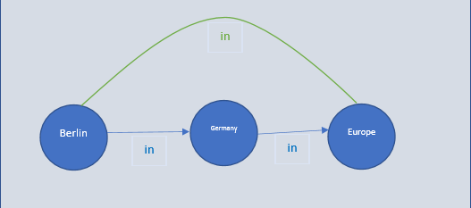
Reasoning on Knowledge Graph
Graph is no complete
Reasoning based on available relations
Query Node: “Band of Brothers”
Query Relation: “tvProgramLanguage”
Query: tvProgramLanguage(Band of Brothers, ?)
English
serviceLanguage
Caesars Entertain…
Actor
personLanguages
countrySpokenIn⁻¹
personLanguages
Neal McDonough
profession
serviceLocation⁻¹
nationality⁻¹
Tom Hanks
United States
castActor
countryOfOrigin
awardWorkWinner
Band of Brothers

Slide 4
Related Works
Path-based methods
Path-Ranking Algorithm (PRA), Lao et al. 2011
Subgraph Feature Extraction, Gardner et al, 2015
RNN + PRA, Neelakantan et al, 2015
Chains of Reasoning, Das et al, 2017
Rank Different paths using random walk
Dense area and fan out issue

Slide 5
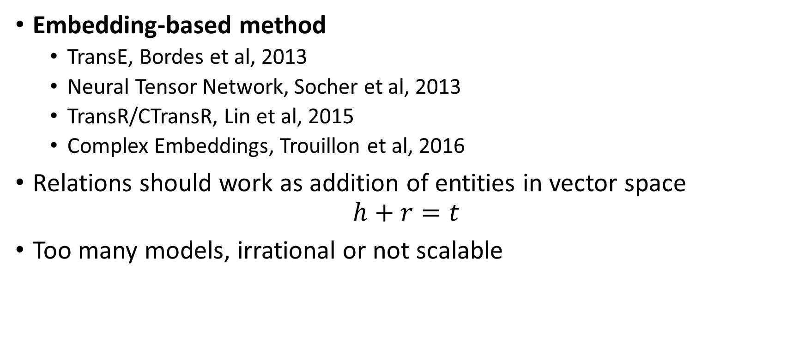
Related Works
Embedding-based method
TransE, Bordes et al, 2013
Neural Tensor Network, Socher et al, 2013
TransR/CTransR, Lin et al, 2015
Complex Embeddings, Trouillon et al, 2016
Relations should work as addition of entities in vector space $h+r=t$
Too many models, irrational or not scalable
r
t
h

Slide 6
DeepPath’s Approach
Learning the paths instead of using random walks
Model the path finding as a MDP
Train a RL agent to find paths
Represent the KG with pretrained KG embeddings
Use the learned paths as horn clauses

Slide 7

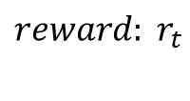
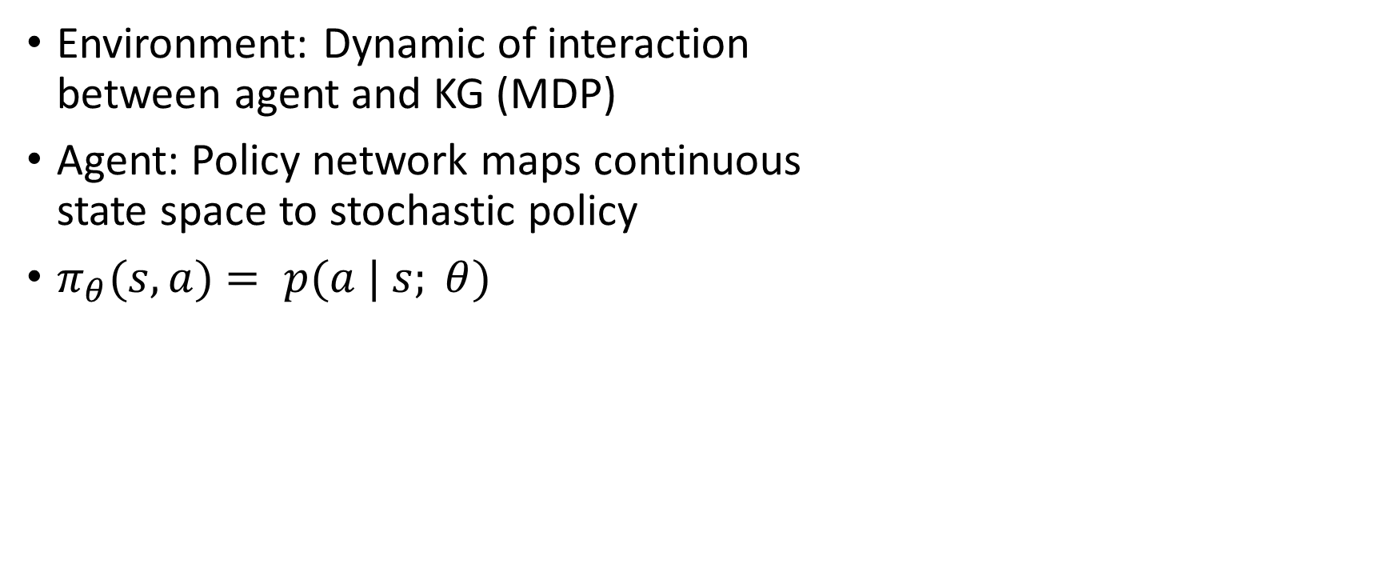
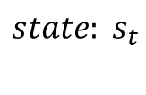


Reinforcement Learning
Environment: Dynamic of interaction between agent and KG (MDP)
Agent: Policy network maps continuous state space to stochastic policy
$π_{θ}(s, a)$ $= p(a | s; θ)$
Agent
$$reward: r_{t}$$
$$state: s_{t}$$
$$action: at$$
$$s_{t+1}$$
Environment
$$r_{t+1}$$
Agent
Environment
Multi-layer neural nets ѱ(s_{t} )
KG modeled as a MDP

Slide 8
RL framework
English
serviceLanguage
Next State
State
personLanguages
personLanguages
ReLU
Caesars Entertain…
Actor
Reward
countrySpokenIn⁻¹
Neal McDonough
profession
ReLU
serviceLocation⁻¹
nationality⁻¹
Reason Step
United States
Tom Hanks
Softmax
castActor
countryOfOrigin
𝛑(a|s)
Band of Brothers
awardWorkWinner

Slide 9
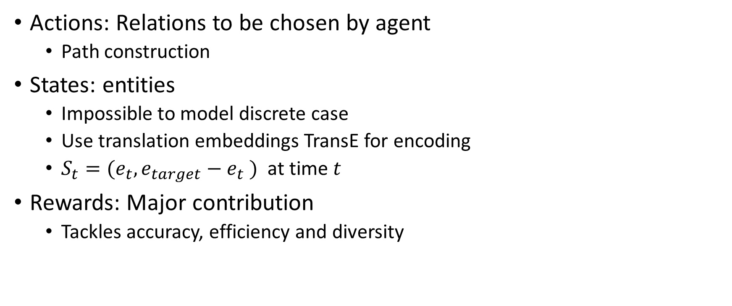
Components of RL
Actions: Relations to be chosen by agent
Path construction
States: entities
Impossible to model discrete case
Use translation embeddings TransE for encoding
$S_{t}=(e_{t},e_{target}−e_{t} )$ at time $t$
Rewards: Major contribution
Tackles accuracy, efficiency and diversity

Slide 10

Reward Functions
Global Accuracy
$r_{global}=\left\{\begin{aligned}+1 ; if reaches the target \\ −1 ; o.w.\end{aligned}\right.$
Path Efficiency:
$r_{efficiency}=\frac{1}{length(path)}$
Diversity:
$r_{diversity}=−\frac{1}{|F|}\sum_{1}^{|F|}{cos(p,p_{i})}$
Notes:
Explain reasons:
Accuracy: many many paths where few of them are accurate so binay reward to prevent from exploring wrong and far space
Efficincy: shorter path are more logical and intuitive
Diversity: agent tend to find similar path to what it has found so far with +1 reward -> redundancy

Slide 11
RL challenges
Typical RL problems
Atari games (Mnih et al., 2015): 4~18 valid actions
AlphaGo (Silver et al. 2016): ~250 valid actions
Knowledge graph reasoning: >= 400 actions
Issue:
large action (search) space -> poor convergence properties

Slide 12
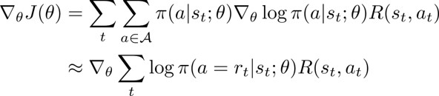
Supervised Policy Learning (Imitation)
Providing a supervision signal to help model as a teacher
Two-side randomized breath-first-search (BFS)
Prevent stucking in intermediate layers

Slide 13
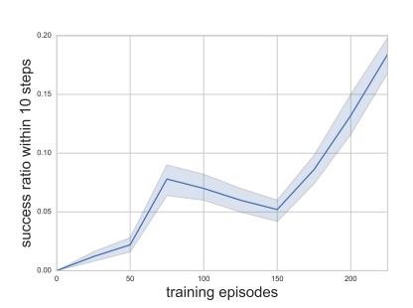
Imitation
Reaching the target within 10 steps
Each episode, one pair of entities
Re-train the agent using reward functions
BFS biased toward shorter paths

Slide 14
Inference Using Learned Paths
Reasoning paths -> predict relation links
Issue: an entity can be connected to many other nodes using same relation links -> poor convergence
Verification using bi-directional search
…
…
Uni-directional search
bi-directional search

Slide 15
Link Prediction Result
Tasks | PRA | Ours | TransE | TransR
worksFor | 0.681 | 0.711 | 0.677 | 0.692
atheletPlaysForTeam | 0.987 | 0.955 | 0.896 | 0.784
athletePlaysInLeague | 0.841 | 0.960 | 0.773 | 0.912
athleteHomeStadium | 0.859 | 0.890 | 0.718 | 0.722
teamPlaysSports | 0.791 | 0.738 | 0.761 | 0.814
orgHirePerson | 0.599 | 0.742 | 0.719 | 0.737
personLeadsOrg | 0.700 | 0.795 | 0.751 | 0.772
…
Overall | 0.675 | 0.796 | 0.737 | 0.789

Slide 16
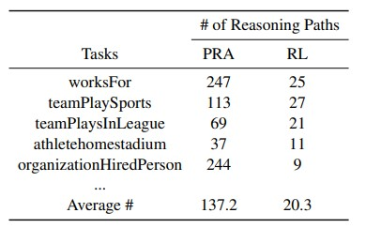
Qualitative Analysis

Slide 17
Qualitative Analysis
placeOfBirth -> locationContains⁻¹
placeOfBirth -> locationContains
personNationality:
peoplePlaceLived -> locationContains⁻¹
peopleMariage -> locationOfCeremony -> locationContains⁻¹
tvCountryOfOrigin -> countryOfficialLanguage
tvProgramLanguage:
tvCountryOfOrigin -> filmReleaseRegion⁻¹ -> filmLanguage
tvCastActor -> personLanguage

Slide 18
Enhancements
Change binary to soft reward
Embedding method uses the corresponding vector space to estimate likelihood
Notes:
f is pretrained – fact score – likelihood

Slide 19

Enhancements
Use dropout actions for diversity
Reaching target using wrong path
Irrelevant query to found path
Randomly masks some outgoing edges for the agent
Sampling:

Slide 20
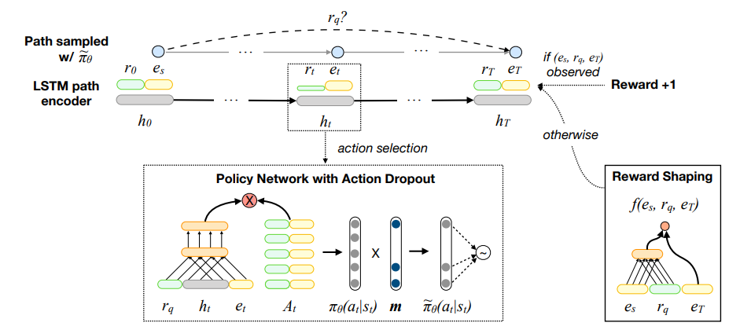
New Framework

Slide 21
Appendix
Link to DeepPath source code: https://github.com/xwhan/DeepPath
Link to salesforce source code: https://github.com/salesforce/MultiHopKG
Link to my source code: https://github.com/Nikronic/DeepPath

Slide 22
References
[1] Sudip Chowdhury, Knowledge Graph: The Perfect Complement to Machine Learning, 2019, medium.
[2] Peter Crocker, The intuitions behind Knowledge Graphs and Reasoning, 2018, Towards Data Science.
[3] Toutanova et al. Representing text for joint embedding of text and knowledge bases
[4*] Xiong, Wenhan, Thien Hoang, and William Yang Wang. "Deeppath: A reinforcement learning method for knowledge graph reasoning." arXiv preprint arXiv:1707.06690 (2017).
[5*] Lin, Xi Victoria, Richard Socher, and Caiming Xiong. "Multi-hop knowledge graph reasoning with reward shaping." arXiv preprint arXiv:1808.10568 (2018).

